Slide 1
Cox Incorporated
Ryan, Piotr and Joseph (Cox)

Slide 2
A definition of the target audience and how our project satisfies them
The target audience for our game is people from 14 to 18.
The main goal is to present the treatments that have been used in the hospital in Victorian times, by creating a top down surgery simulation game with a mix of humour to keep players interest.
We are educating users not by using text based or quiz games, but keeping their interest using their reaction and multitasking capabilities.
Patrick E. Turner's report (Turner, 2018) states that games are a great help for young people in regards to learning, so if our target audience goes and plays our game, they will have a greater comprehension of the things they have learnt throughout the infirmary tour.
According to ISFE's report (ISFE, 2012):
61% of parents have children who play video games
70% of parents believe their children have more fun playing games
55% of parents believe their children develop more skills while playing video games
39% of parents believe their children are more creative as a result of games

Slide 3
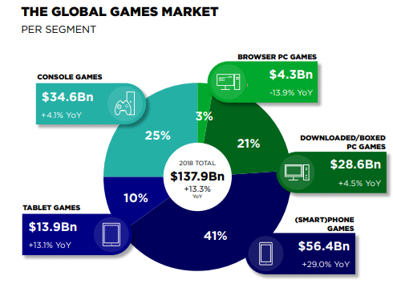
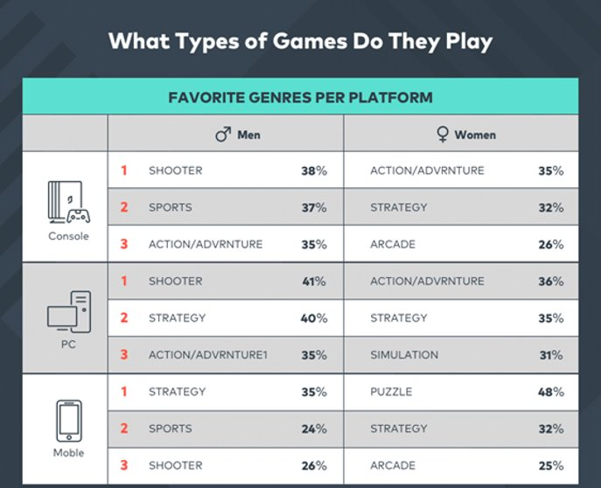
Mobile and PC platform considerations
In our research, we discovered that smartphones are the most popular platform for games now. The chart on the left (Newzoo, 2018) shows this.
However, we'll primarily develop for PC as that will make development easier for us.
By developing for the most ideal genre and platform combination, we would be able to attract our target audience much more effectively.

Slide 4
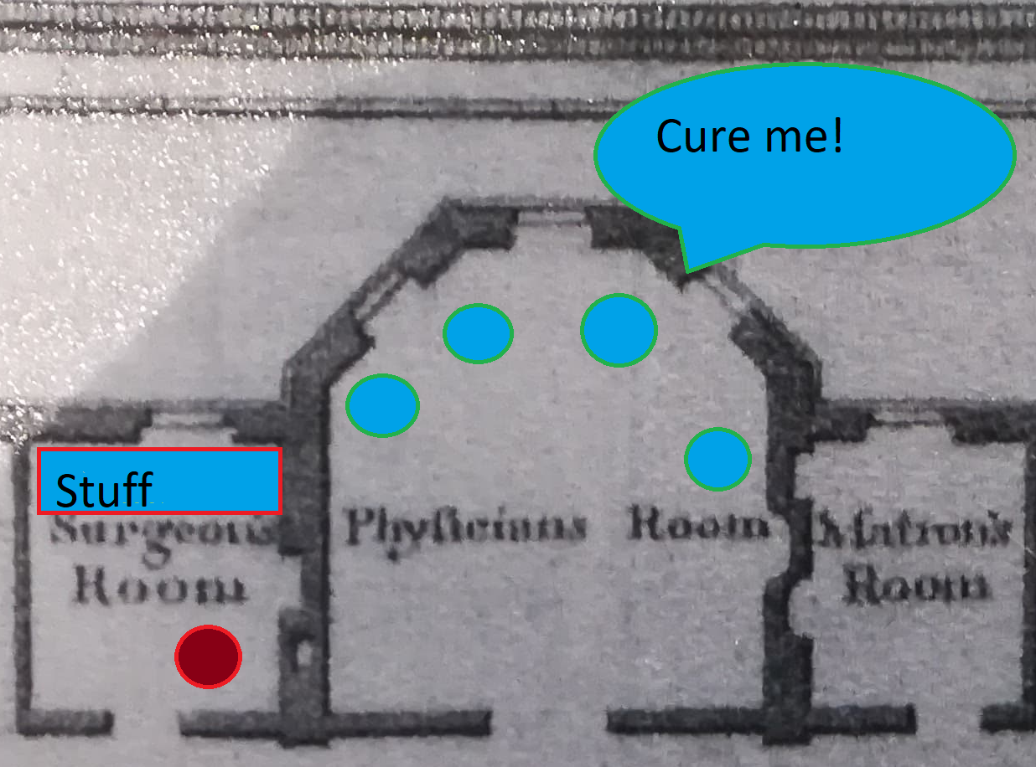
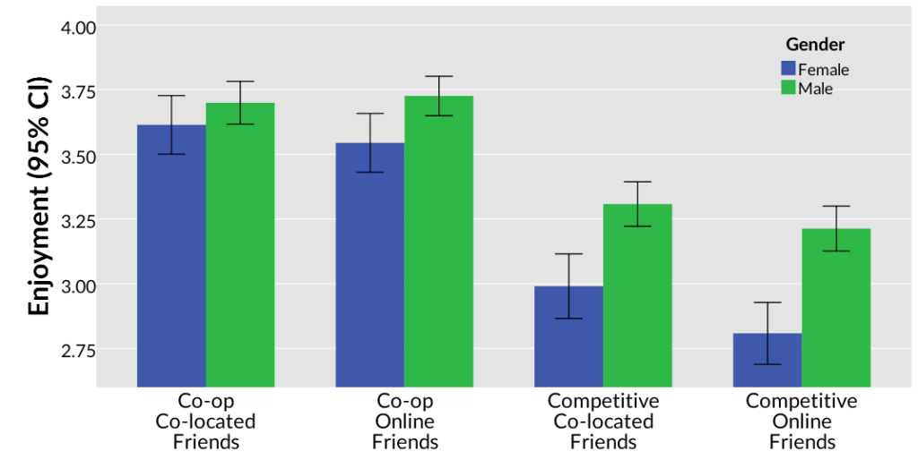
What our game will be like
The image on the left is how the game world will look (approximately).
Our game will focus on the simulation and puzzle genres.
So we'll develop our game so that it matches the expectations and conventions of these genres, thus allowing our target audience to be able to enjoy the game we eventually create.
We would like to include local co-op, as Kaleb Embaugh's article on Quantic Foundry (Embaugh, 2016) states that local co-op is a type of gameplay that a large percentage of people enjoy the most, as highlighted by the graph in the middle which also comes from Embaugh's article.

Slide 5
Description of the core types of activities and how those activities will engage the player
The main activities will be to treat the patients according to their illness as fast as you can.
The player will be engaged by the constant need of focusing on the tasks provided by game, as well as by series of activities that will cure (or won't cure) your patients.
An example of one of the activities would be to amputate a limb. To accomplish this, the player will have to find the correct tool they need. In this case, it is the bone saw.
They will then have to complete a quick time event and depending on how close to perfect their timing is, the better chance they will have of saving that patient.
The quick time event will engage the player by forcing them to work on their reaction times, while having the pressure of keeping the patient stable.

Slide 6
Context within our game
The story is about a doctor that is the youngest in a family of medical practitioners and the player will be the one who decides how long his career will last.
The main objective of the game is to save the lives of several patients by finding their symptoms and use the corresponding remedy.
The game is set in mid 1800 and will be about the Worcester infirmary, and the ways of curing diseases in those times.

Slide 7
Consideration for level design and how it might showcase the core gameplay mechanics
There will be multiple levels within the game to progress through and each level will be based on the infirmary building itself.
The area that the player starts in will be a tutorial area, to get the player used to the core game mechanics.
The player will be able to unlock different sections of the building as the game progresses. For example, one of the more difficult levels would be the children's ward.
By designing the map this way, we can give the player a bigger objective of working towards unlocking the more difficult areas other than the base objectives (treating patients).
All the patients' rooms will be close together to make it easier for the player to manage multiple objectives at one time. It'd also mean it wouldn't take too long for them to get to each room.

Slide 8
Reference List
Brown, L. (2019). Digital Video Game Trends and Stats for 2019 [online] wondershare/filmora. Available at: https://filmora.wondershare.com/infographic/video-game-trends-and-stats.html [Accessed 14th October 2019]
Embaugh, K. (2016). Local Co-Op is The Most Consistently Appealing Mode of Social Gaming Across Gender and Age [online] Quantic Foundry. Available at: https://quanticfoundry.com/2016/07/21/social-gaming/ [Accessed 13th October 2019]
ISFE (2012). VIDEOGAMES IN EUROPE: CONSUMER STUDY [online] ISFE. Available at: https://www.isfe.eu/wp-content/uploads/2018/11/euro_summary_-_isfe_consumer_study.pdf [Accessed 16th October 2019]
Newzoo (2018). Global Games Market [online] Newzoo. Available at: https://resources.newzoo.com/hubfs/Reports/Newzoo_2018_Global_Games_Market_Report_Light.pdf?utm_campaign=Games%20Market%20Report&utm_medium=email&_hsenc=p2ANqtz-93Xu8VqDs6szT503OsLWrNNaKrt0gC8gEVhgGWm4HCOdz_4JcVHLNfcA8Eo33XqdhwnBW-dVGouT3Th4F0FOyfGAlYfQ&_hsmi=63907018&utm_content=63906677&utm_source=hs_email&hsCtaTracking=ffa42eb3-9f57-4ca1-bccb-425a3cd98d81%7C075c1c69-ce55-4aba-9c03-5d441d779476 [Accessed: 16th October 2019]
Turner, P. (2018). Influence of online computer games on the academic achievement of nontraditional undergraduate students [online] tandfonline. Available at: https://www.tandfonline.com/doi/full/10.1080/2331186X.2018.1437671 [Accessed: 16th October 2019]

